Slide 1


Slide 2


Slide 3
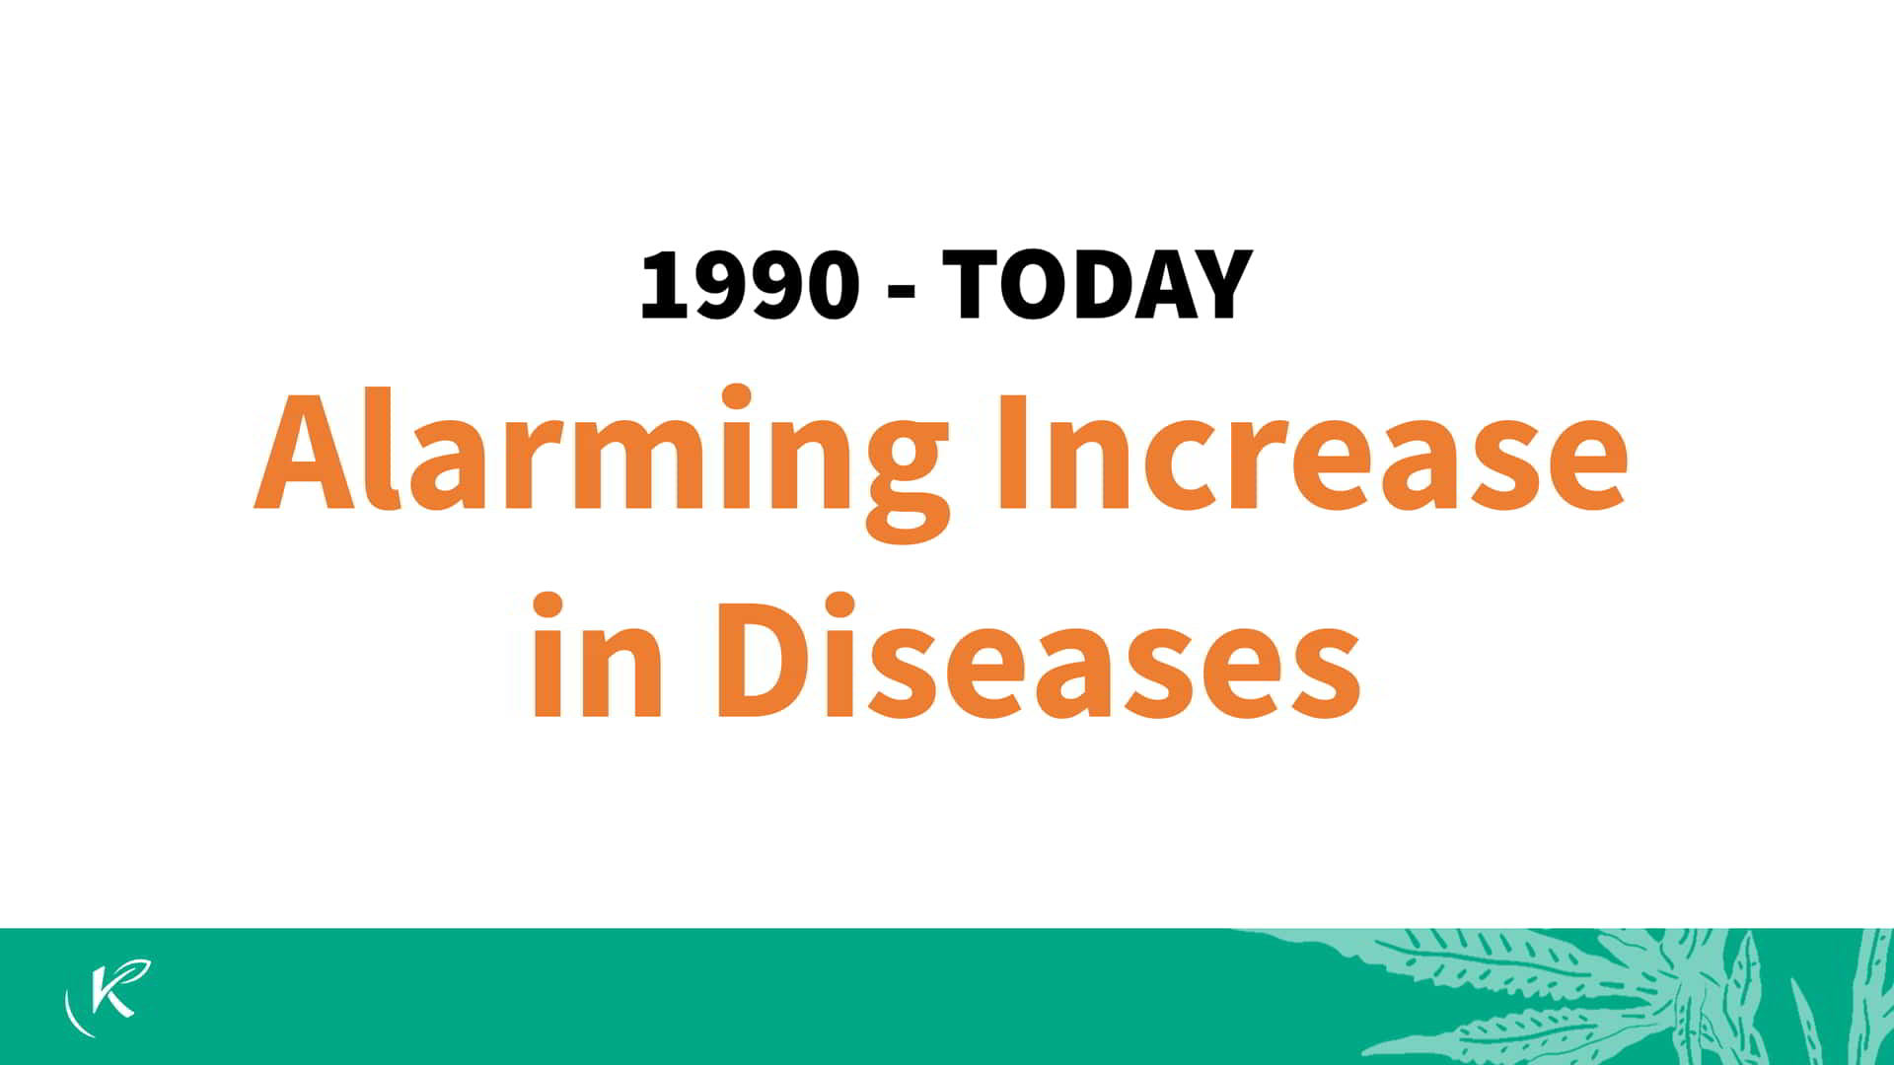

Slide 4
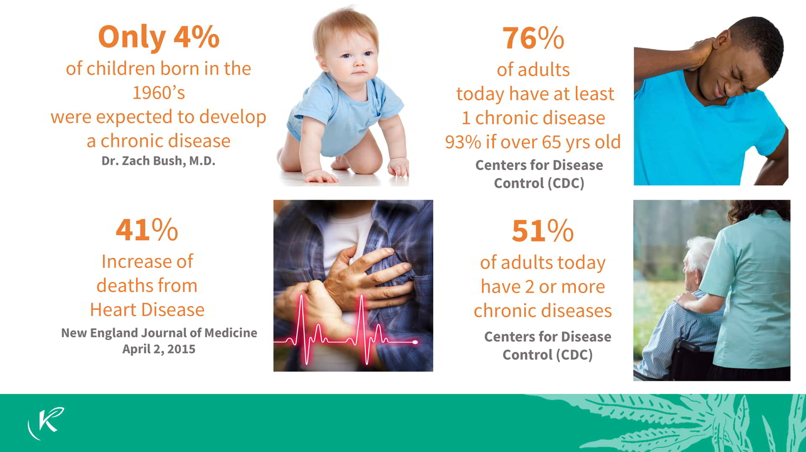

Slide 5


Slide 6
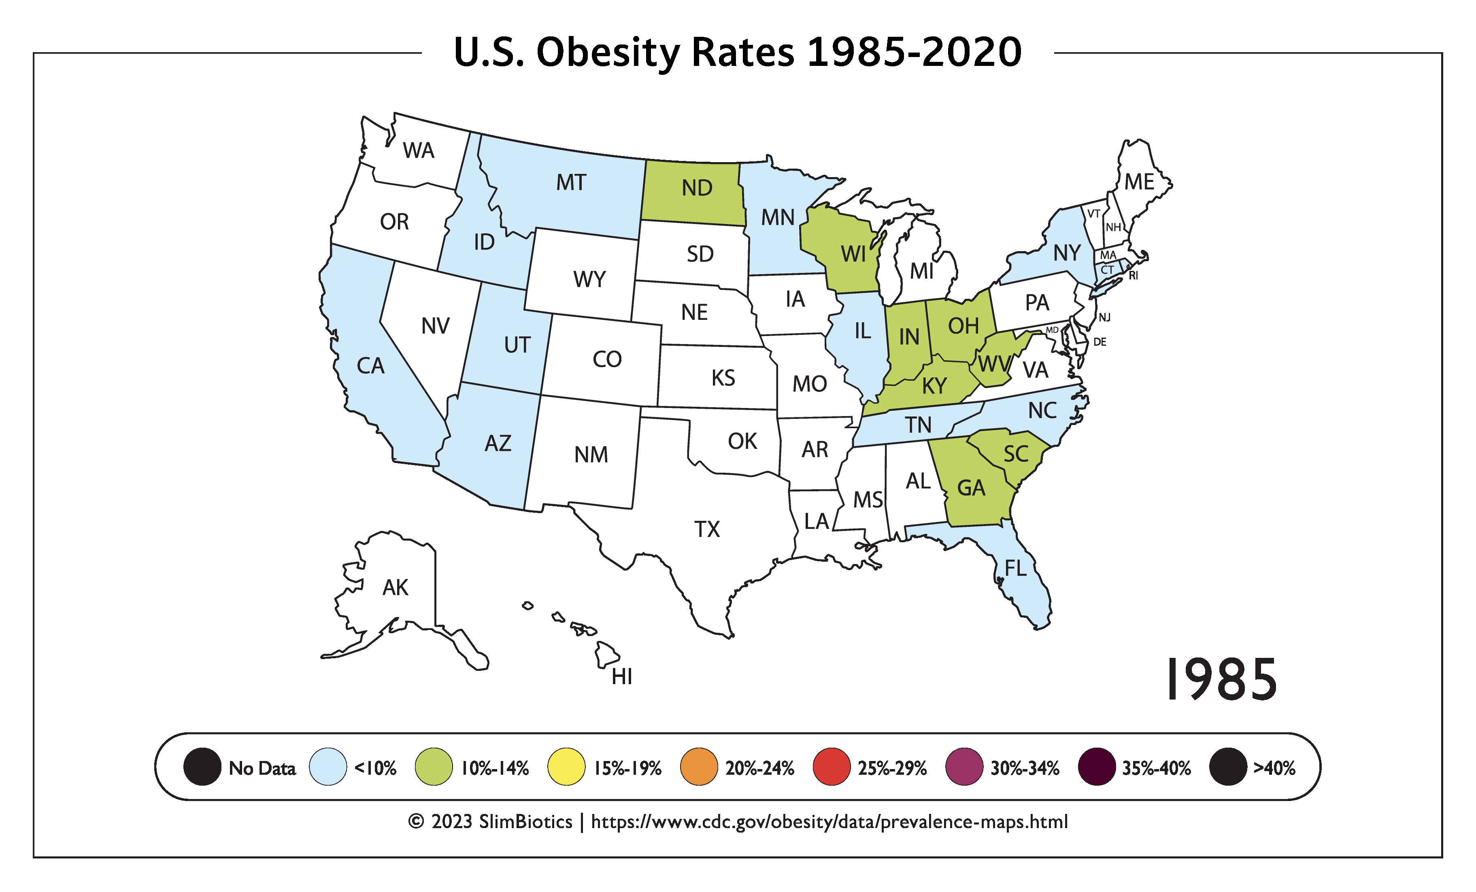
208 million Americans are classified as obese or overweight, according to a new study synthesizing 132 data sources

Slide 7


Slide 8
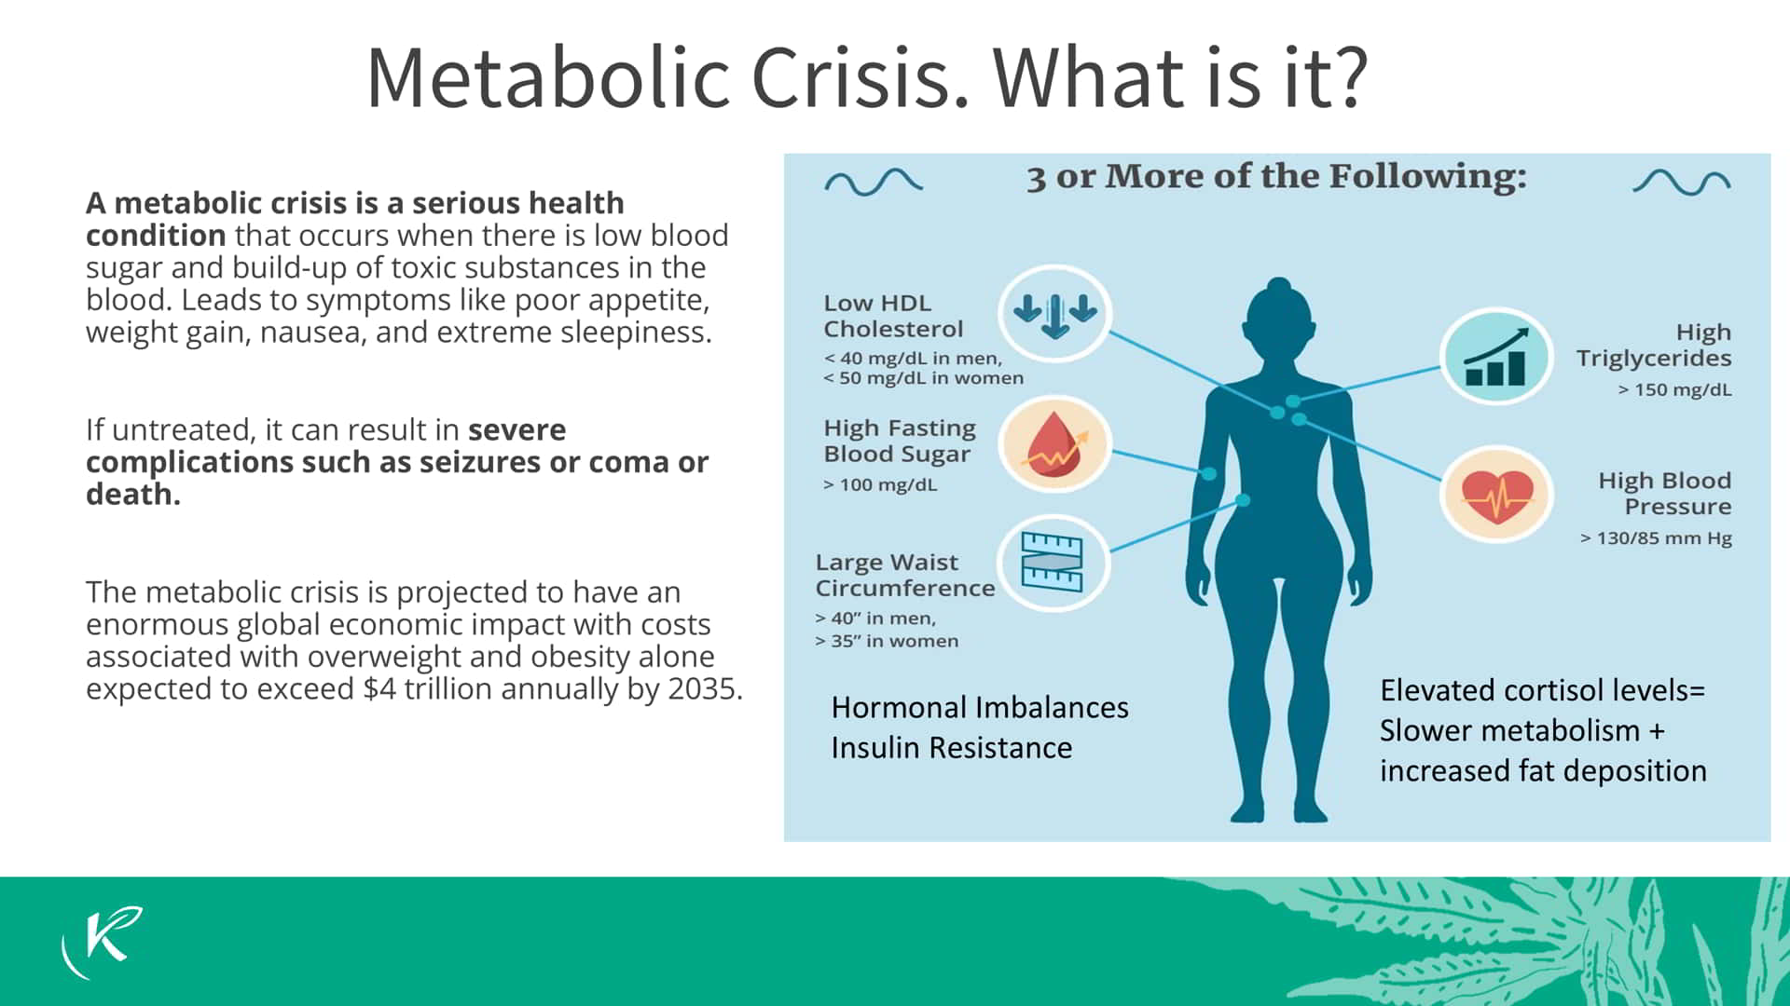

Slide 9
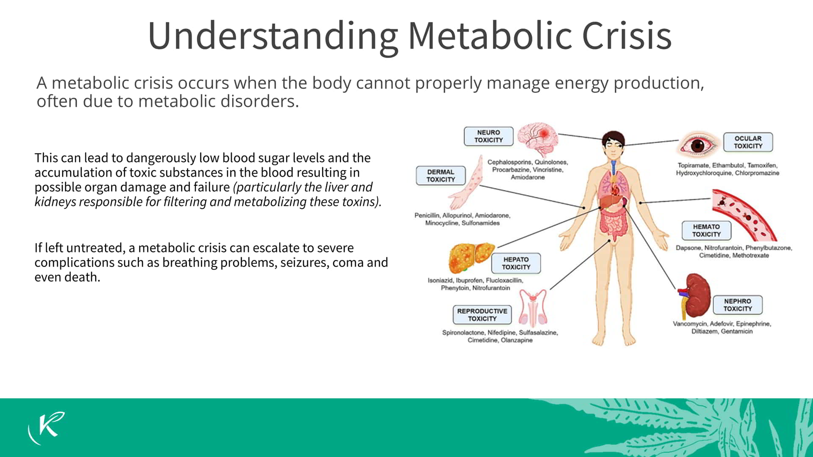

Slide 10
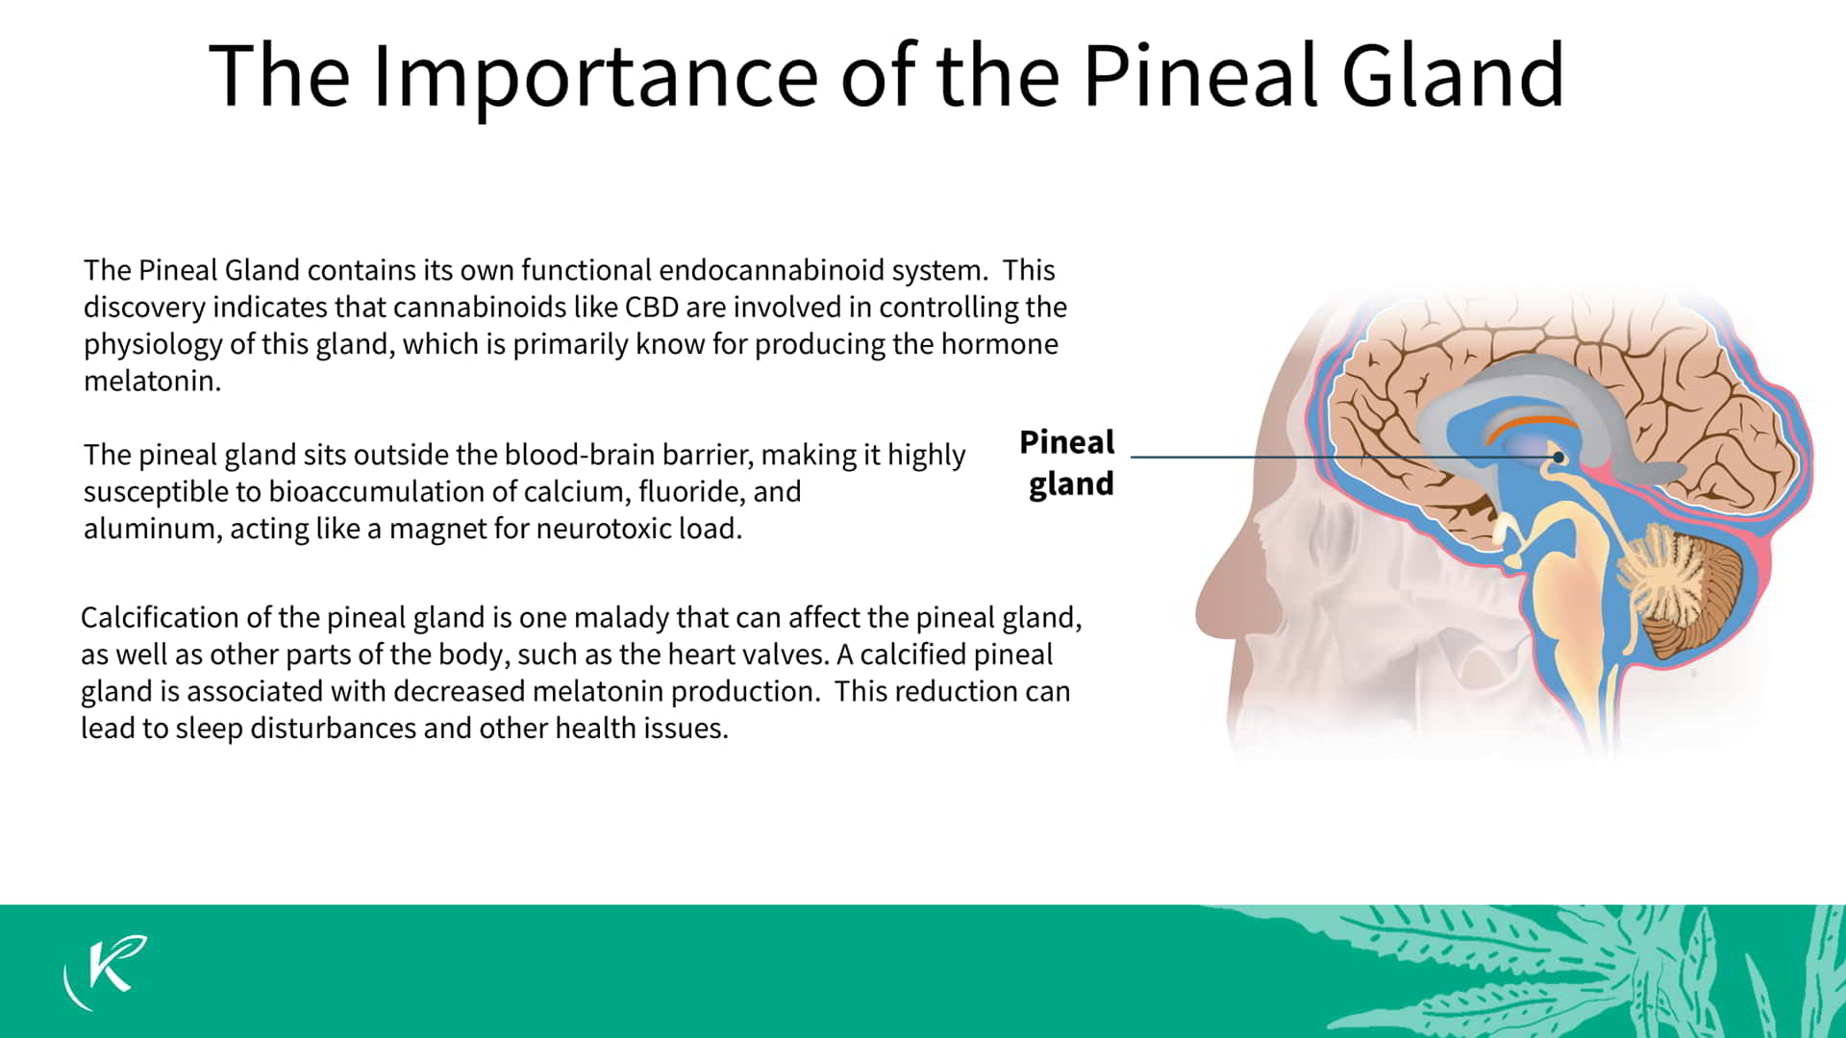

Slide 11
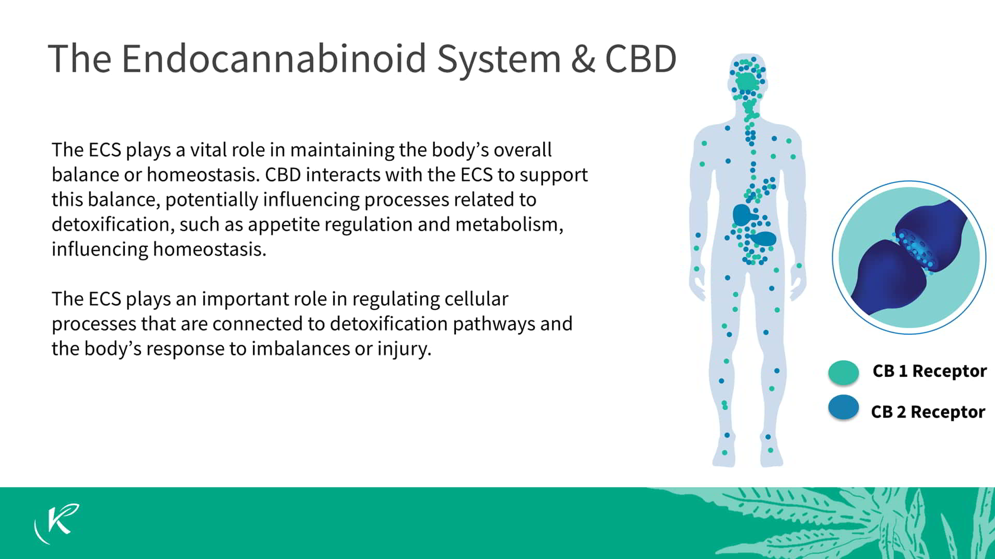

Slide 12


Slide 13
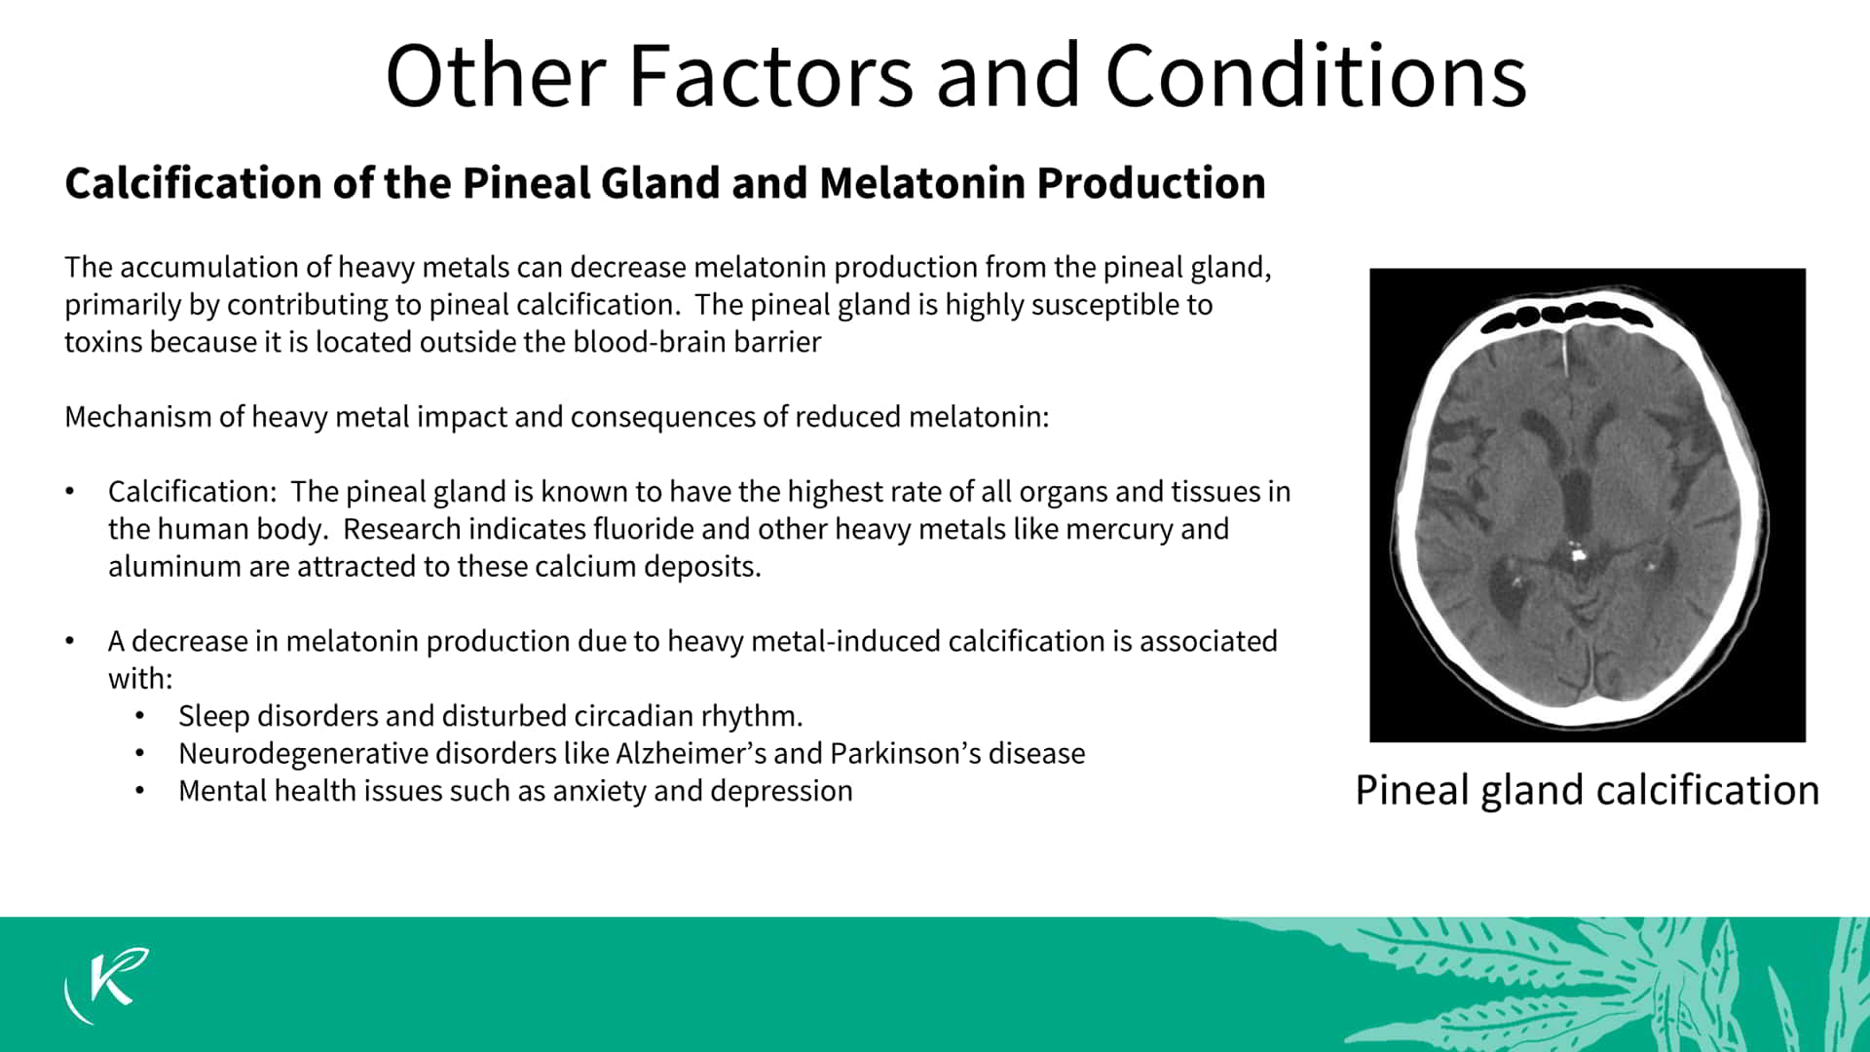

Slide 14
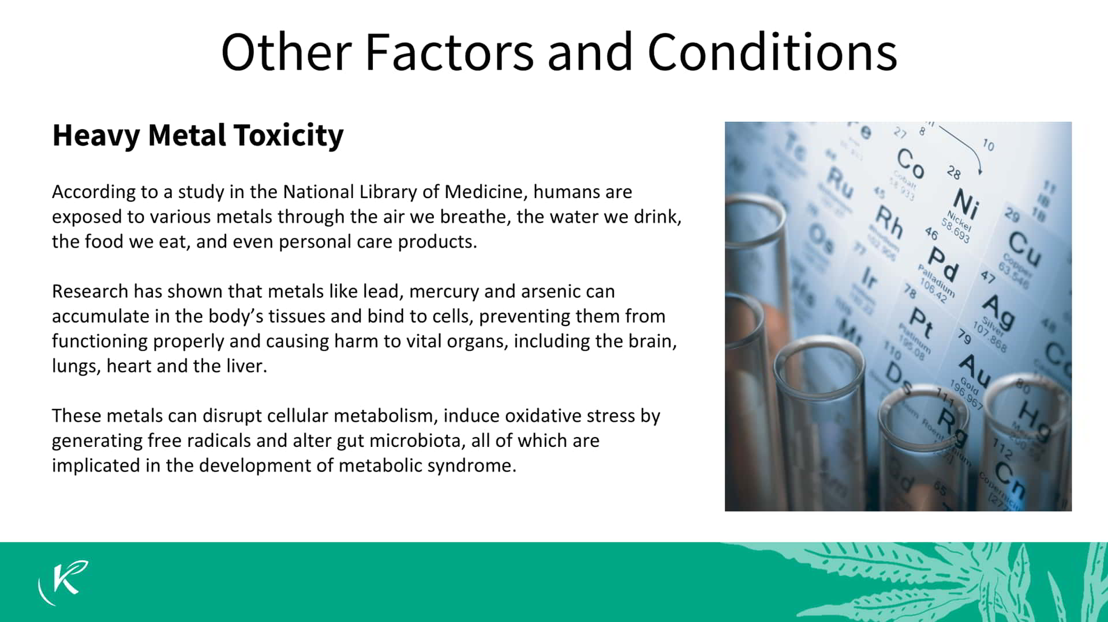

Slide 15
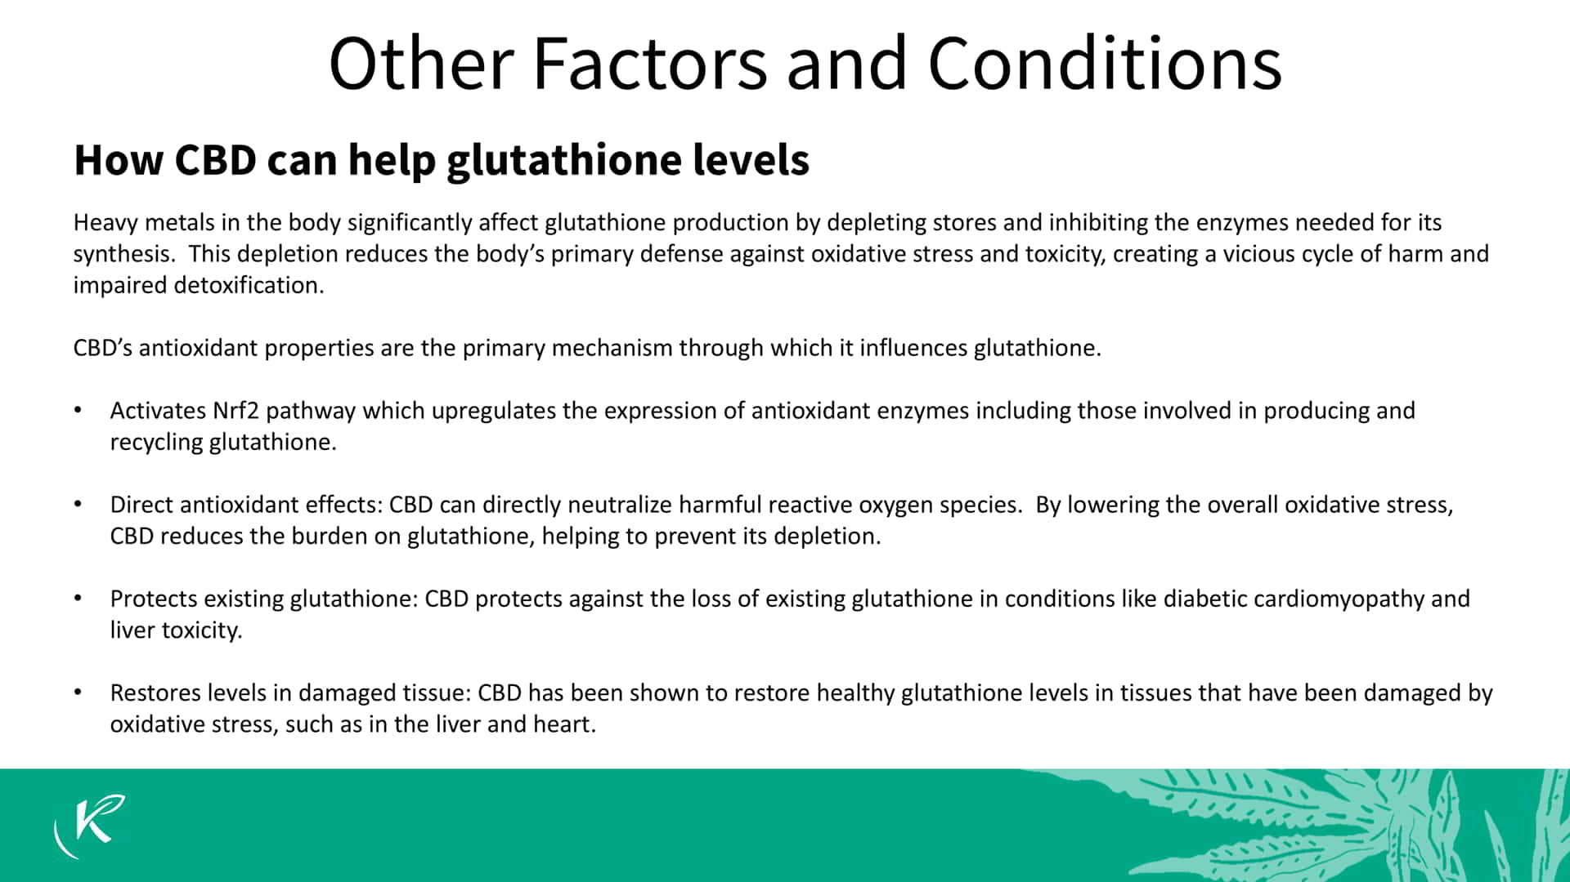

Slide 16


Slide 17


Slide 18
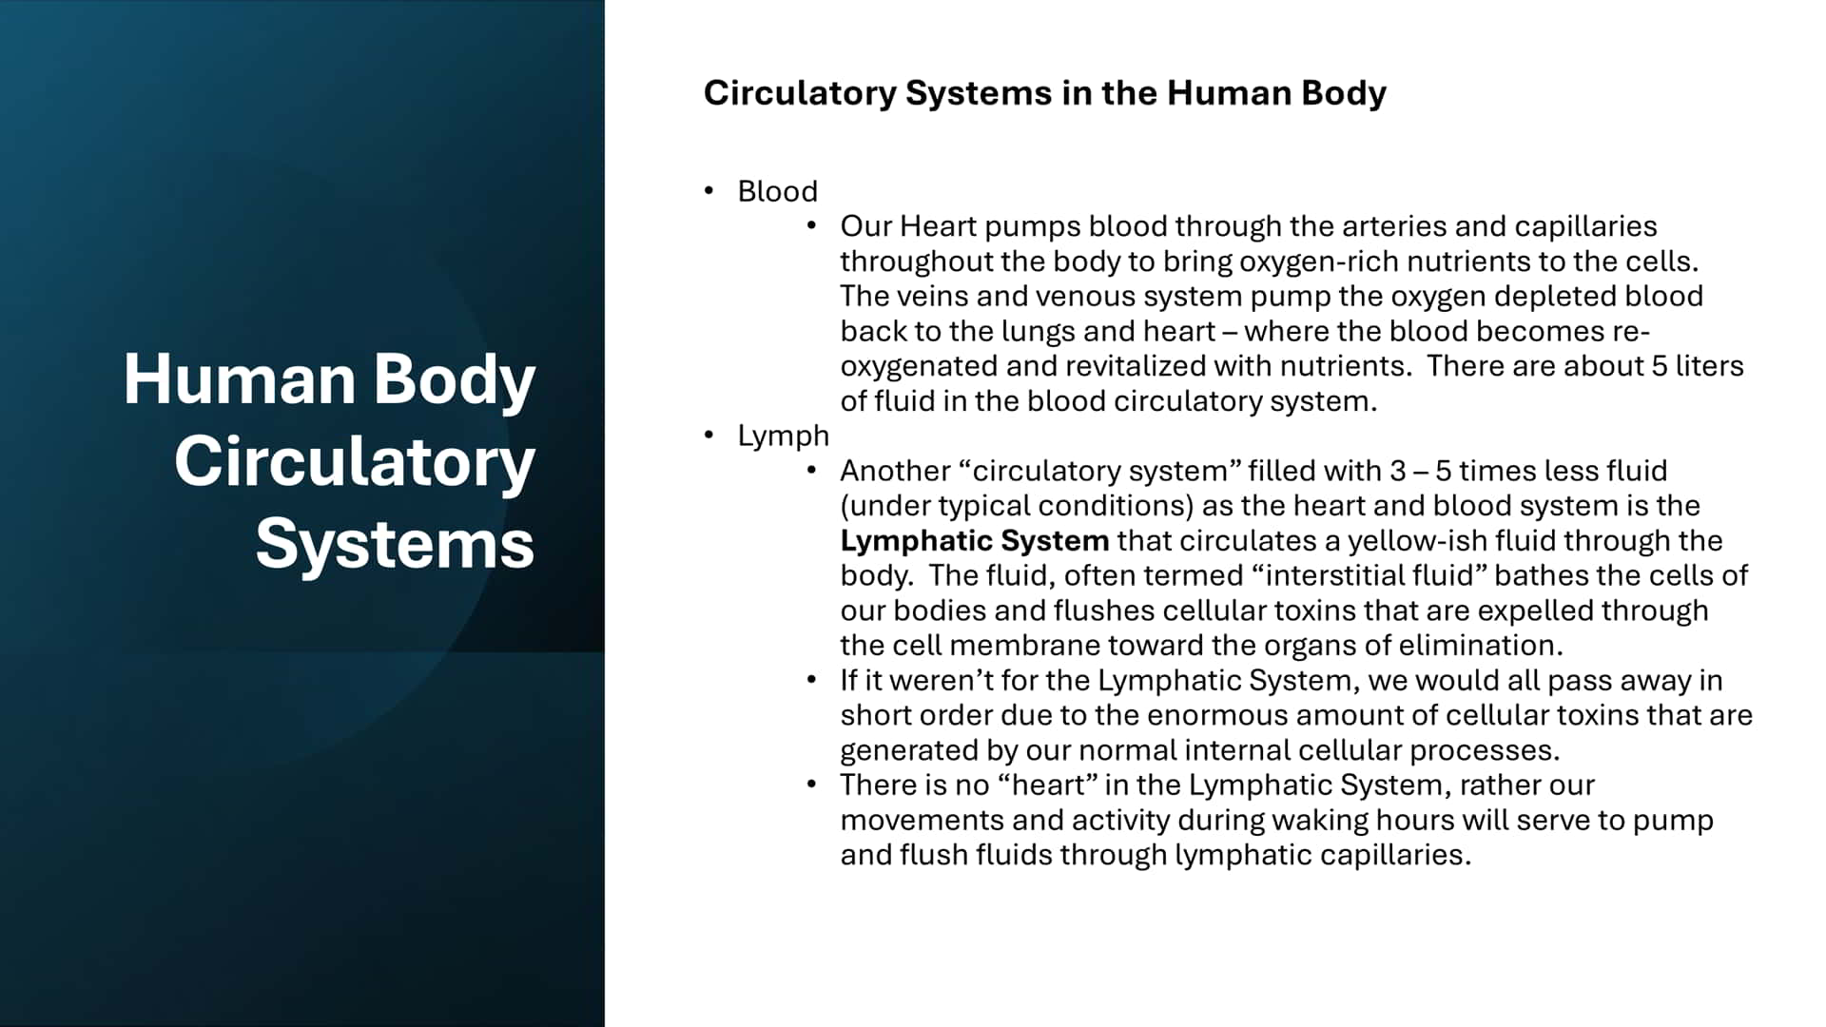

Slide 19
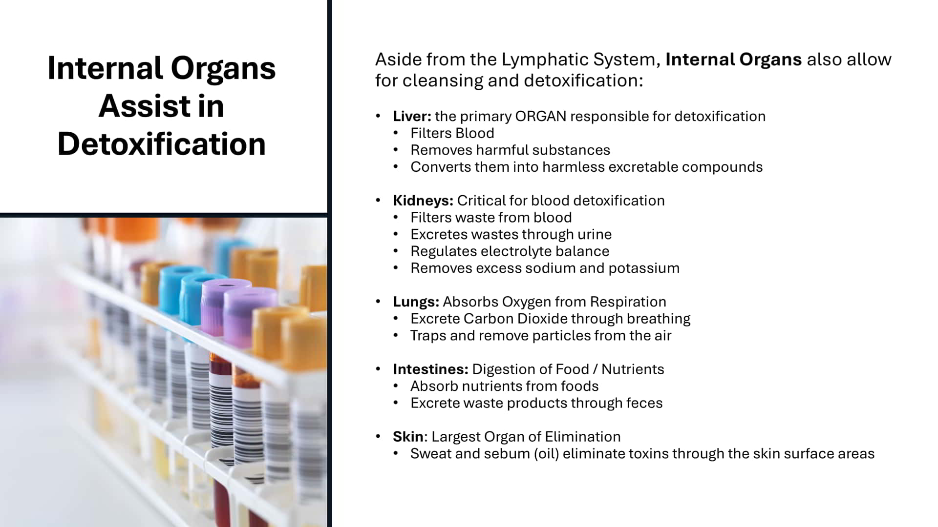

Slide 20


Slide 21
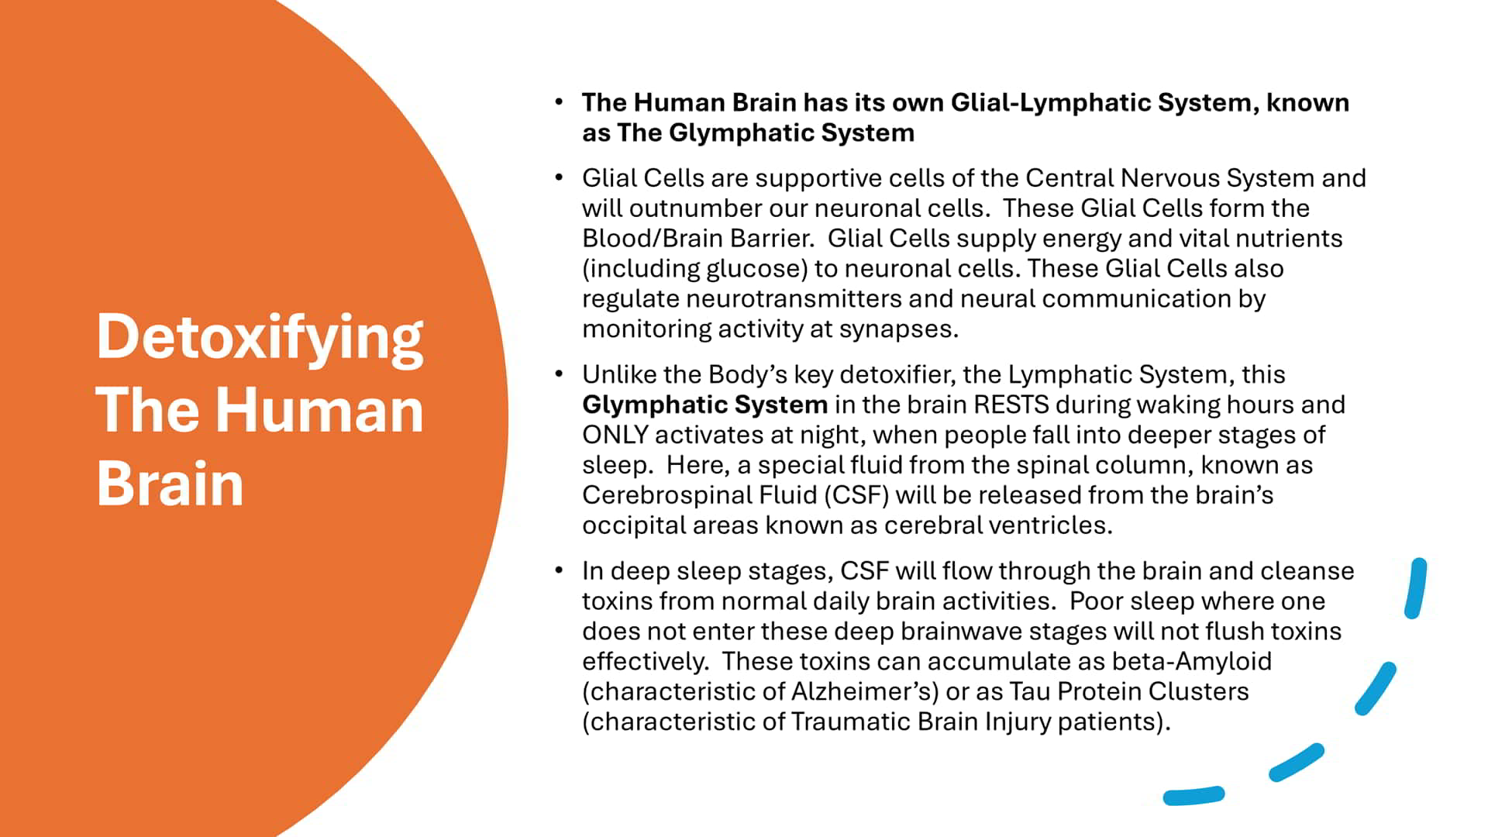

Slide 22
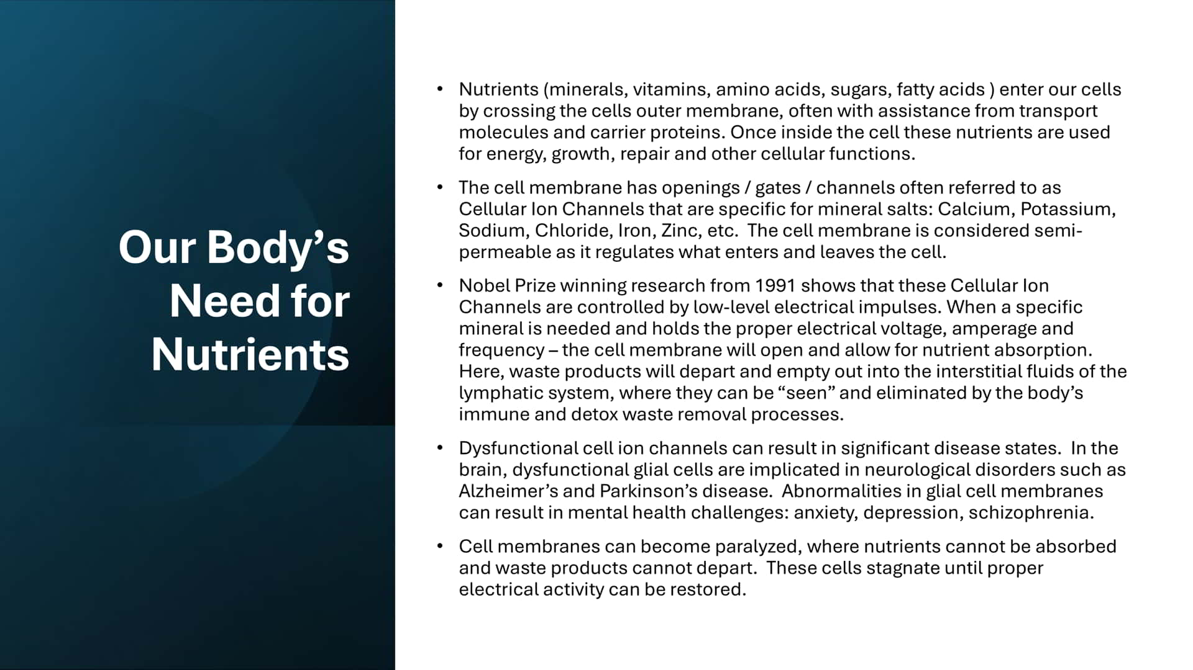

Slide 23


Slide 24


Slide 25
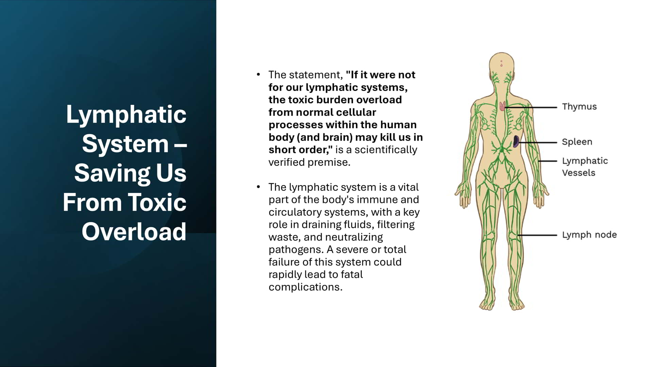

Slide 26


Slide 27


Slide 28
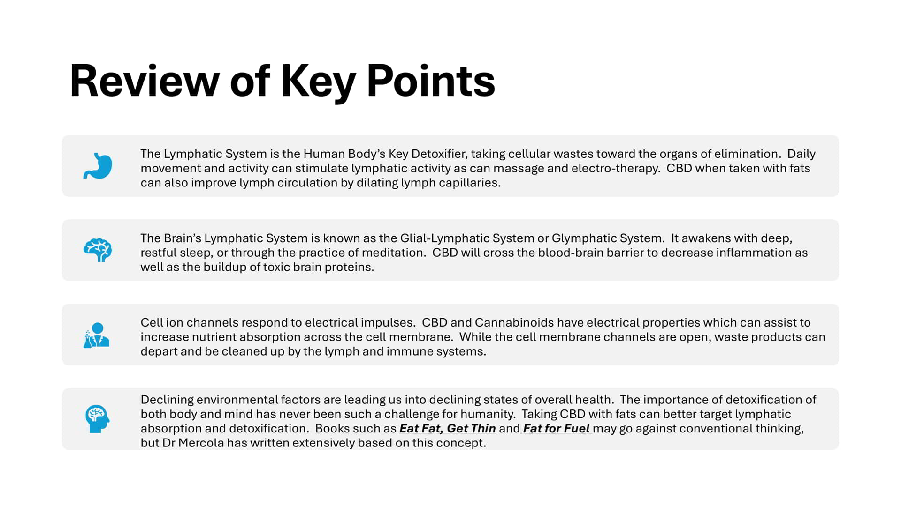

Slide 29


Slide 30


Slide 31


Slide 32


Slide 33


Slide 34


Slide 35


Slide 36


Slide 37


Slide 38


Slide 39


Slide 40


Slide 41


Slide 42


Slide 43


Slide 44


Slide 45


Slide 46
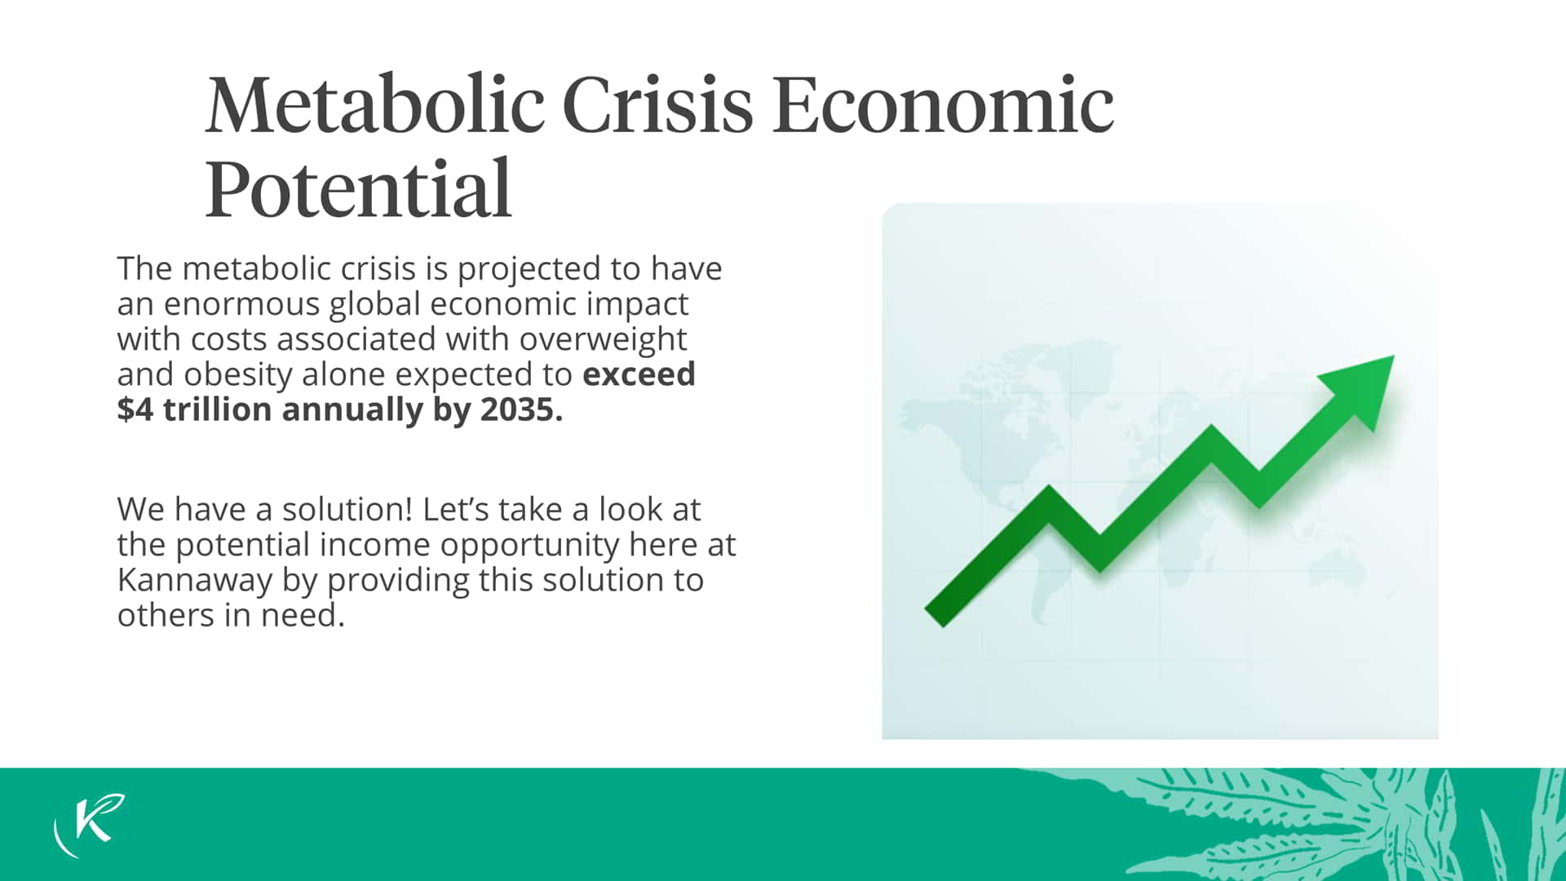

Slide 47


Slide 48


Slide 49
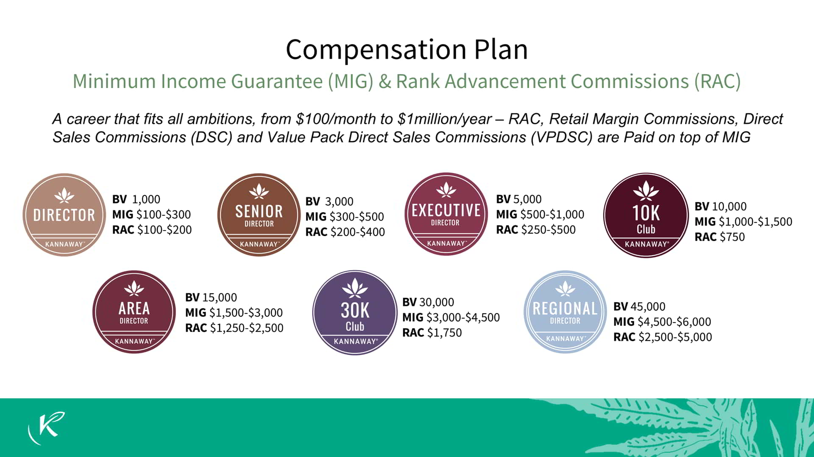

Slide 50
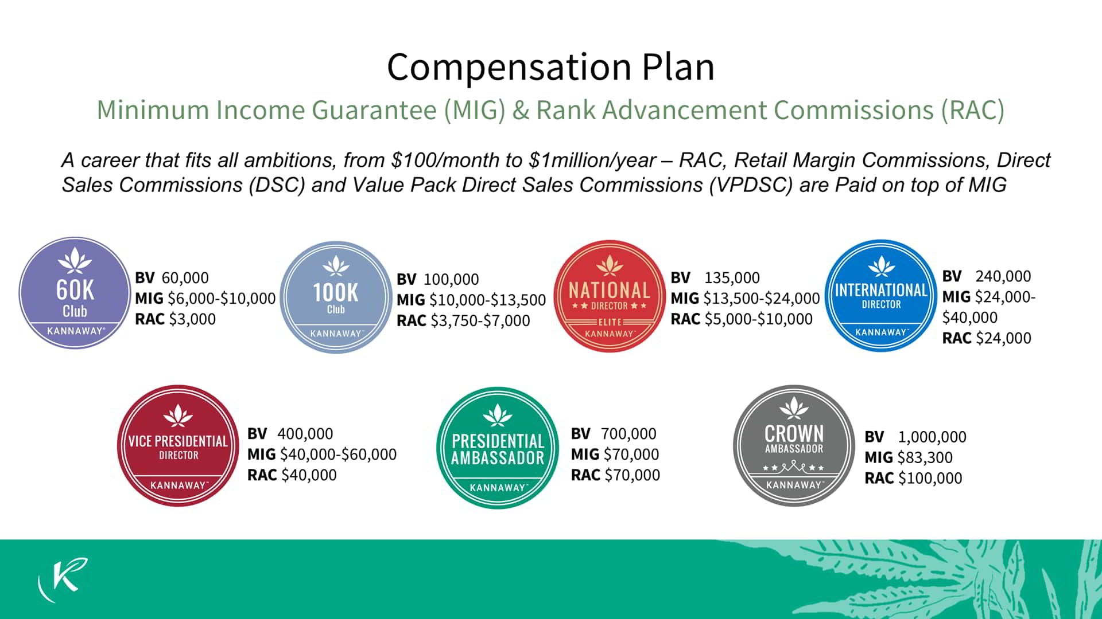

Slide 51


Slide 52


Slide 53


